Slide 1

GROUP 05
TEAM PLANNERS
PARTICIPANTS
SUBIRA RAJAB
SEBASTIAN MAJIRI
BALTAZAR DEOGRATIUS

Slide 2

01
02
03
04
GROUP NAME
CONTENT
PROBLEM
TARGET
05 06
SOLUTION
EXISTING
SITUATION AND
PROPOSED DESIGN

Slide 3

PROBLEM
Inadequate access to
public spaces

Slide 4
TARGETED
GROUP
Youth (18-35 years old)
case study
kimara mwisho to mbezi mwisho
( morogoro road)

Slide 5
SOLUTION
TO optimaze the utilization of
the public spaces
value added
increase interaction odf the
people.
making the area to be more
vibrabt and eganging

Slide 6
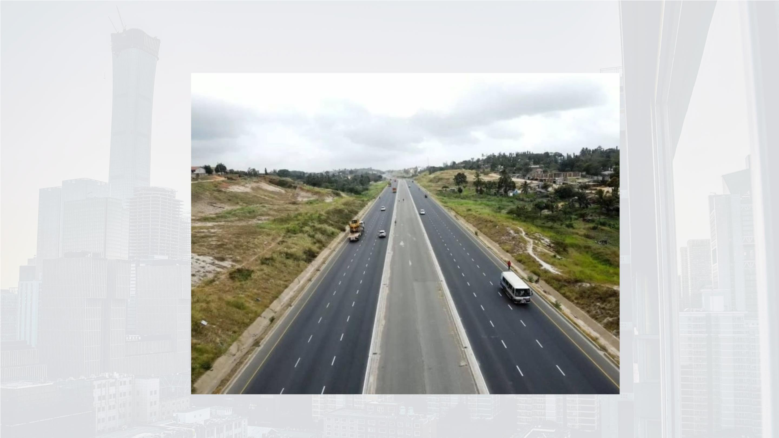

Slide 7
