Slide 1


FLEXIBLE HOUSE DESIGN
EAGLES
SABRINA MABISO
DAVID DALLAS
PHILIPO MAGOYO

Slide 2
Story
Asha is a single mother, selling cassava and lives in a single room with his two children during rain times her business affected and her safety is at concern.

Slide 3
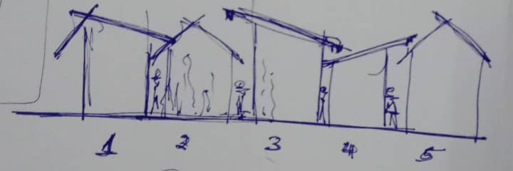
Problem
Low income earners facing challenges of non compliance of building standard leading to poor housing.

Slide 4
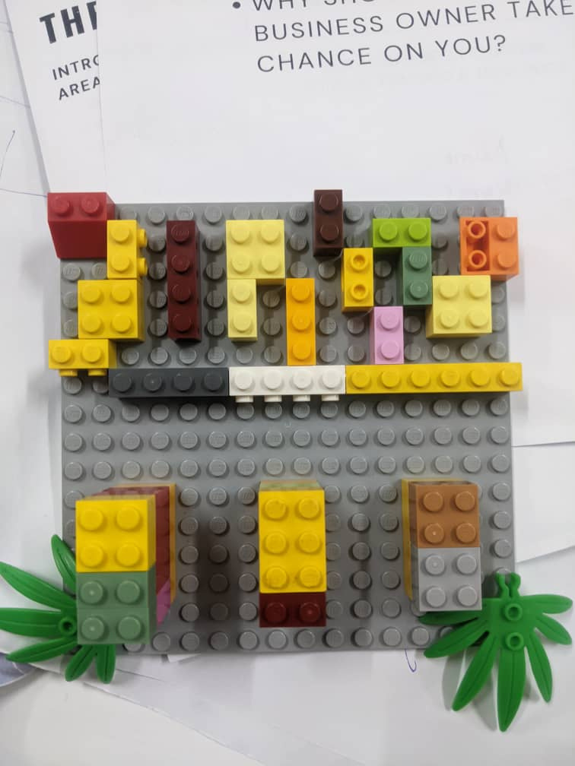
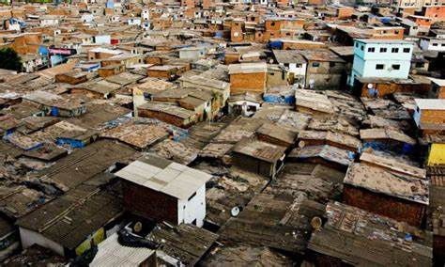
A model and picture of housing condition in Vingunguti

Slide 5
Solution
Bridging low income earners to build sustainable housing based on flexible building standards.
  Designing models of houses with flexible building standard at low cost.
  Creating platforms where low-income earners can access engineering solution for sustainable house design (Intergrated planning)
  Guiding people to have access to financial services. e.g.. Plan for areas with high business potential and for areas with low business potential

Slide 6
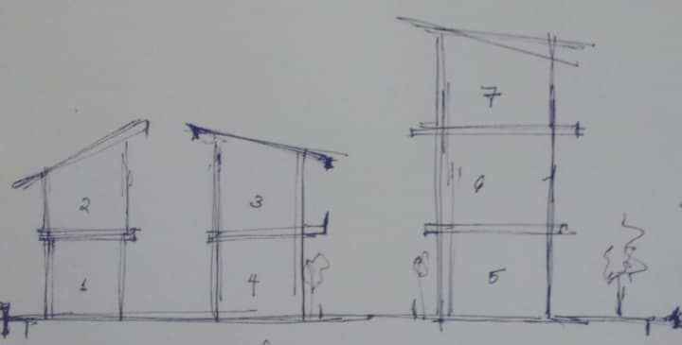
A model and picture of sustainable housing

Slide 7
Example
Asha visit our platform (e.g. website) to explore sustainable house design which are flexible and low cost.
Then she will be connected to other stakeholders (engineers, planners, financers & etc).
Under participatory, transparent, equity and accountability princples

Slide 8
Thank you
EAGLES
SABRINA MABISO
DAVID DALLAS
PHILIPO MAGOYO

