Slide 1


AYA TECH
ADVENTINA ADOLF - 0768588573
YESSE SAMWEL - 0786874544
ANTIDIUS KAWAMALA - 0769806836

Slide 2
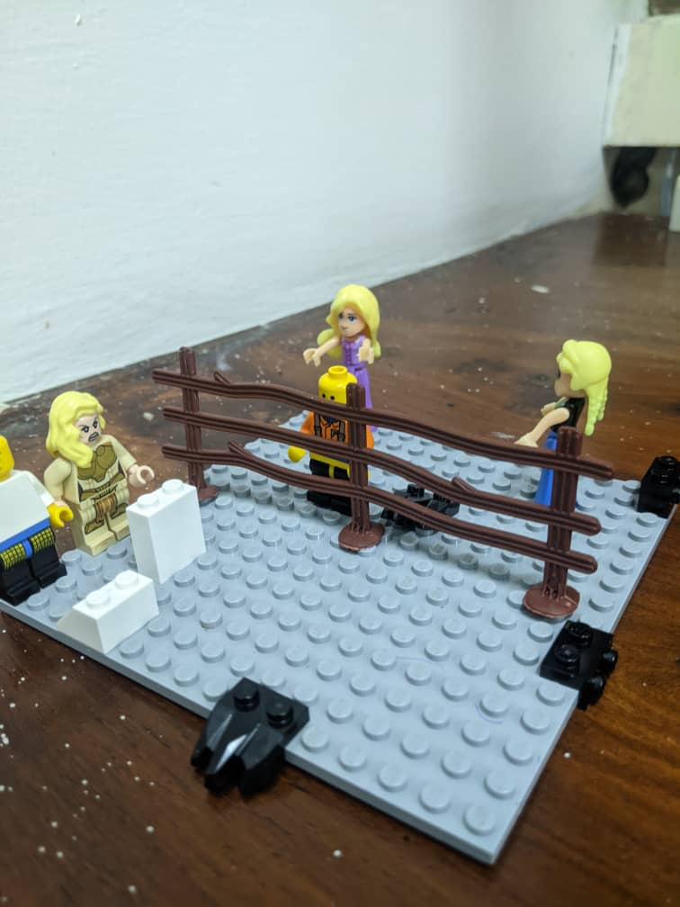



ISSUE
Lack of awareness and transparency on the legal framework regarding land Occupancy.
There is a need to have an integrated platform to ease the process of occupying land.

Slide 3
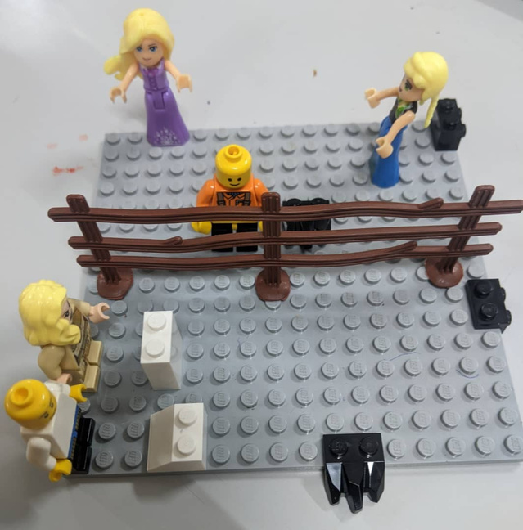
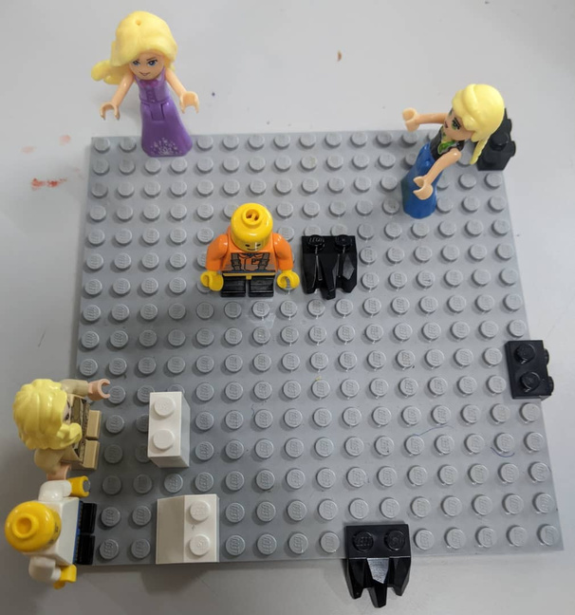
POSSIBLE SOLUTION (ARDHI PORTAL)
Developing an integrated / Decentralized WEB PORTAL that provides transparency, and accessibility of Land information towards access and tenure security
Decentralized (ARDHI PORTAL)
Centralized

Slide 4




TARGETED GROUP
LOCAL COMMUNITY
BUSINESS GROUPS
PLANNING AUTHORITY

Slide 5





IMPORTANCE
.
INTERGRITY
TRANSPARENT
TIME SAVER
Crowdsourced Data

Slide 6

THANK YOU

