Slide 1
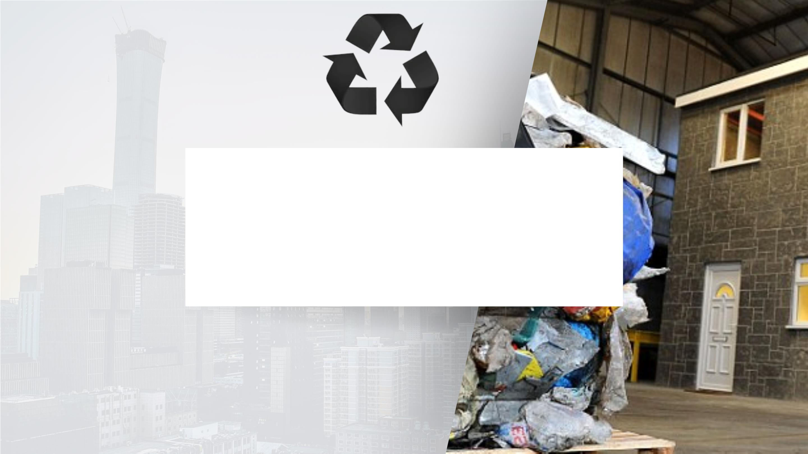
TURNING SOLID WASTE
INTO AFFORDABLE
HOUSING
FINANCER GROUP 3

Slide 2
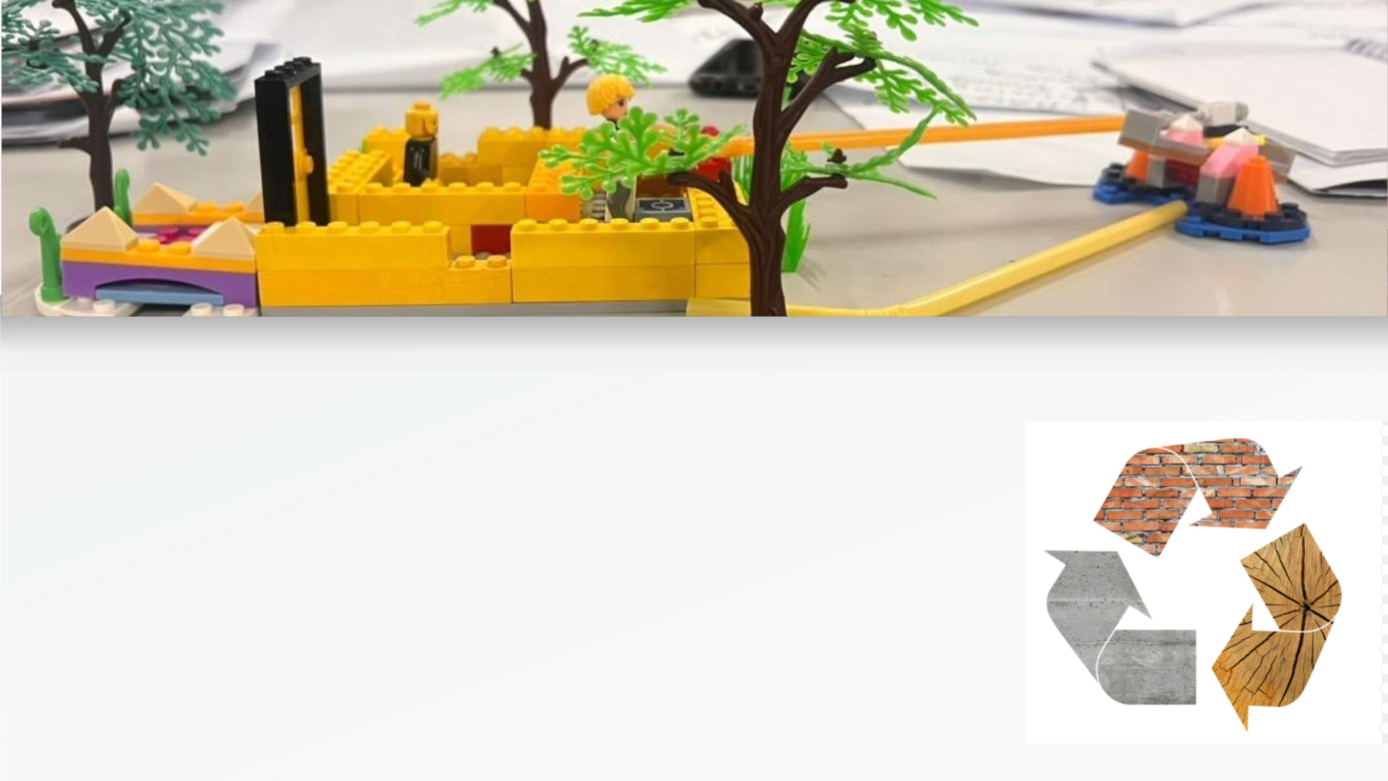
INTRODUCTION
• Low-income families face a dire
shortage of affordable housing options,
while waste generation remains a
growing concerns
Our Target User: Low-income community

Slide 3
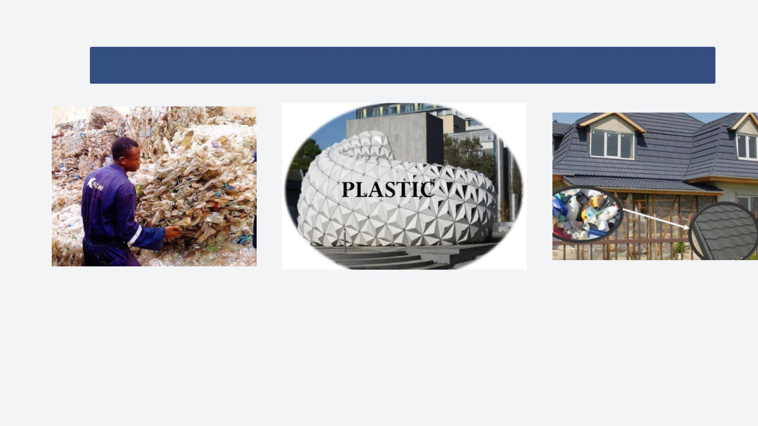
SOLUTION: Affordable Housing For Recycled
Materials
Collect and process solid waste material,
transforming them into durable, eco-friendly
building material for constructing affordable
homes

Slide 4
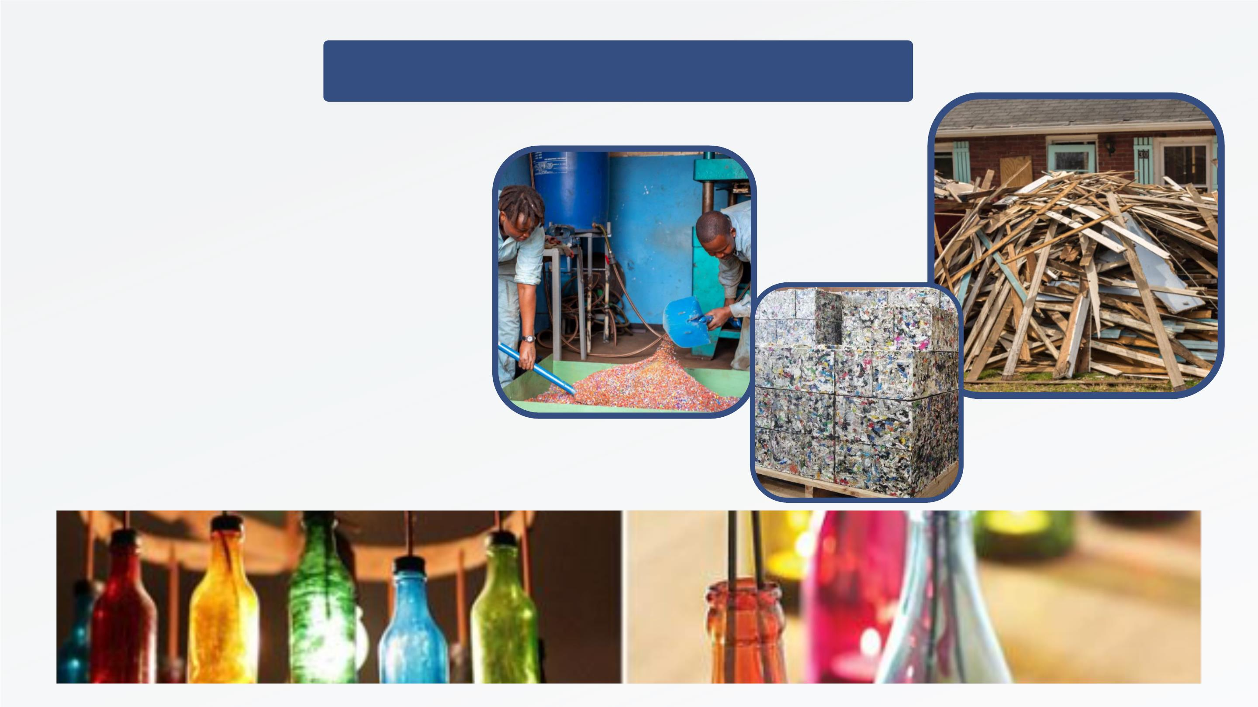
IMPLEMENTATION
STRATEGY
• Expertise in waste
management and
construction should
provide education to the
community
• Local government, NGO
and Construction
experts to identify
suitable locations and
communities in need.

Slide 5
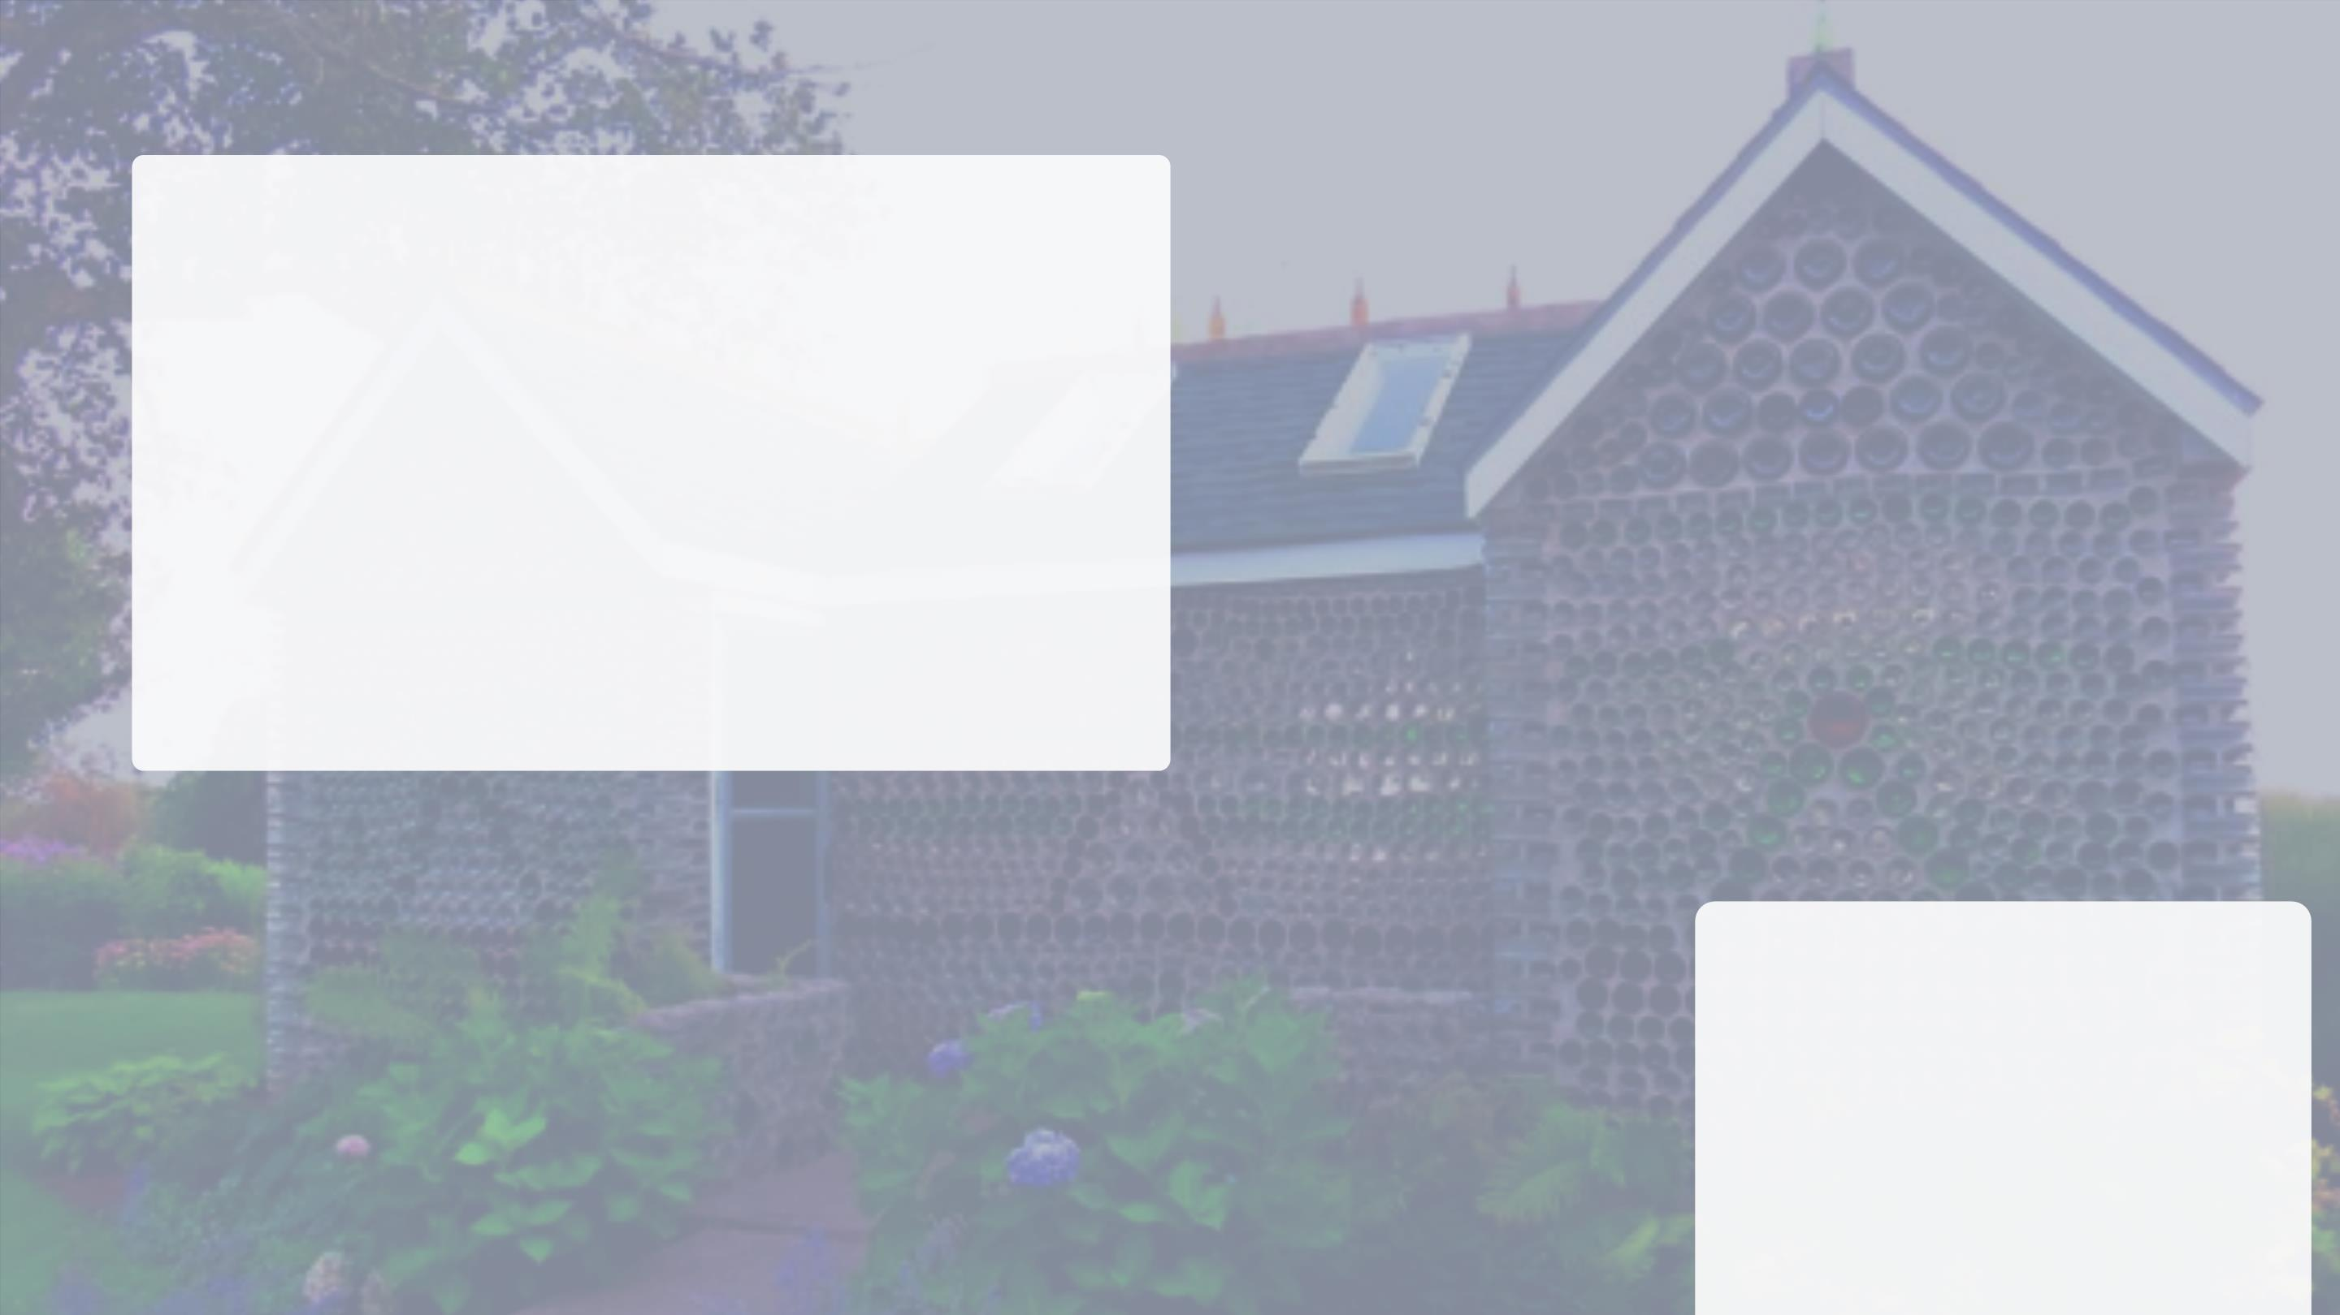
We invite you to join
us in making a
tangible impact on
affordable housing
and waste reduction
GROUP MEMBERS
• Gloria Changullah
• Mpomolelu Kawunju
• Haji Mohammed
• Joshua Estelatus
• Mustapha Maulid

