Slide 1


GROUP 4

Slide 2
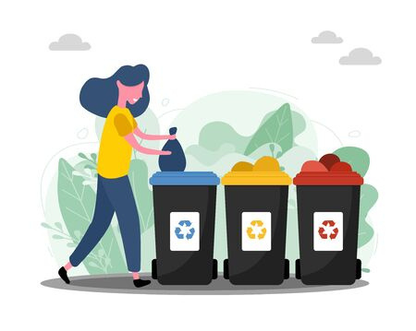
PROBLEM STATEMENT
Poor sorting of household solid waste in Informal settlements of Urban areas that are negatively affecting the health and economic status of Chausiku

Slide 3

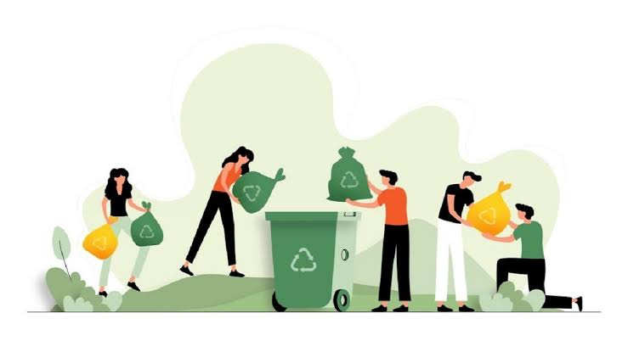
Awareness creation on sorting of household solid waste
SOLUTIONS
Provision of sorting tools i.e buckets, plastic garbage bags
Building a cash flow chain by connecting stakeholders and producers

Slide 4

Market
  Families in informal settlements
  Average solid waste per household is 20-25kg in a month whereas food waste is 15kg. We can sell them to stakeholders such as chanzo for fish meals, and green recycling companies for manure production. (Vice President 2020)

Slide 5

THE TEAM
1. SAID IDDI RAIS - ENVIRONMENTAL ENGINEER
2. SWEDI RAJABU - ENVIRONMENTAL EXPERT
3. REBECCA C KIBONA- HOUSING AND INFRASTRUCTURE PLANNER
4. REHEMA GODSON MNKENI- TOWN PLANNER
5. YOHANA MATIKO ISACK- ENVIRONMENTAL ENGINEER

Slide 6

Thank you!

